Slide 1
CS 2600 Computer Networks I Dr. Sayeed Sajal Lecture 10 Encoding

Slide 2
Major Telecommunications Carriers (“Telecoms”)
Top U.S. long distance and mobile carriers
Verizon (purchased XO, a fiber optic carrier, in 2017)
AT&T (acquired Time Warner Media* in 2018)
T-Mobile (trying to merge with Sprint, may not succeed)
CenturyLink (purchased Level 3,a fiber optic carrier in 2017)
Top U.S. cable TV/Internet operators
Comcast (Xfinity)
Time Warner Cable* (acquired by Charter Communications, rebranded as Spectrum)
Cox Communications
Largest foreign carriers (some were PTTs, most are now multi-national)
Vodafone (UK) • Telefonica (Spain) • Bharti Airtel (India)
France Telecom • NTTC (Japan) • Rogers (Canada)
China Mobile • British Telecom
Telecom Italia • Alcatel-Lucent (France)
Deutsche Telekom • America Móvil (Mexico)
*Time Warner Media and Time Warner Cable are two different companies

Slide 3
Common Data Rates Available From the Carriers

Slide 4
DS1/T1 and DS3/T3 Circuits
Characteristics
Provide point-to-point (non-switched) digital data transfer over conditioned copper wiring
DS1 links operate at 1.5Mbps
"DS1" and " T1" are often used interchangeably
DS3 (T3) service is 45Mbps
Both DS1 and DS3 require a network interface device on both ends called a DSU/CSU (Data Service Unit/Channel Service Unit)
Rates or tariffs are based on distance
DS1 is around $300/month city and $500/month rural
Typical DS3 is around $3000/month
Advantages
Economical for ongoing bulk transfer between fixed points
Reliable, with accurate diagnostics (troubleshooting)
Widely available in urban U.S.
Disadvantages
Point-to-point circuit (not switched)
Relatively high cost

Slide 5
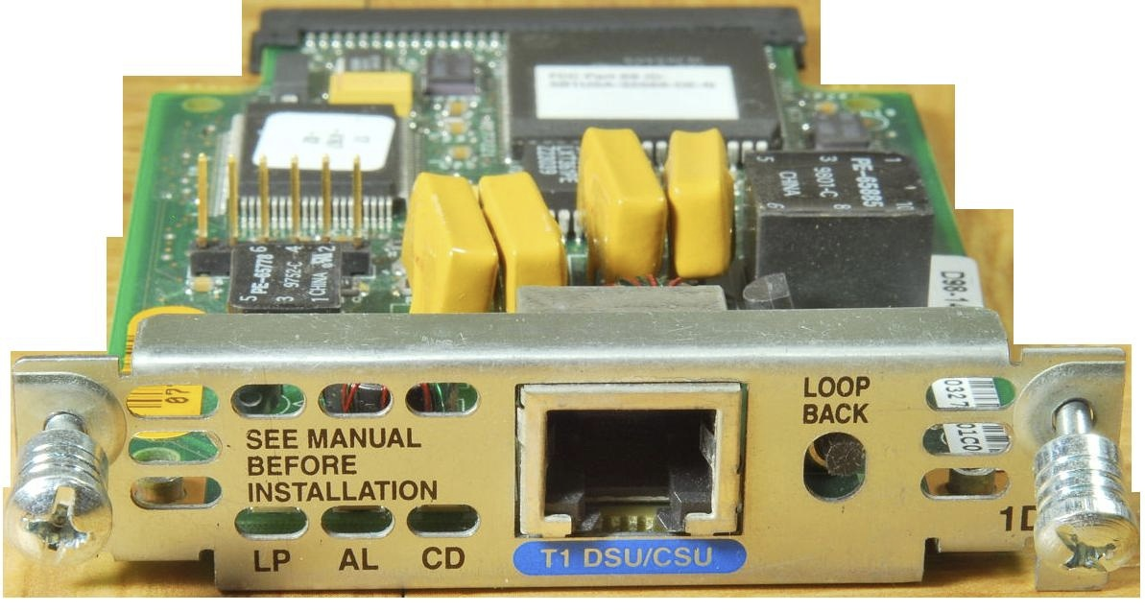
T1 DSU/CSU Network Adapter for a Cisco Router

Slide 6
Common Bandwidths Available From the Carriers
*Synchronous Transport Signal, the circuits used in Synchronous Optical Networks (SONET)

Slide 7
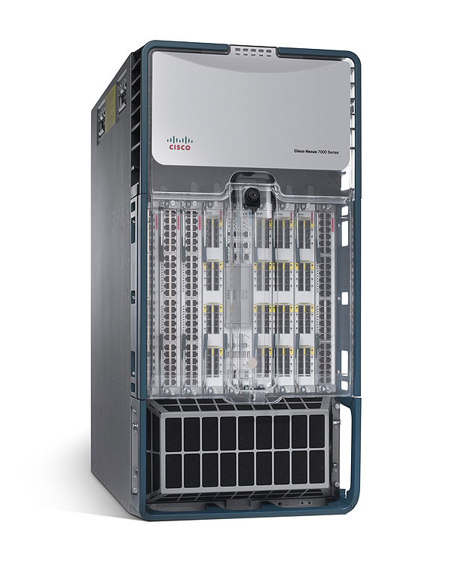
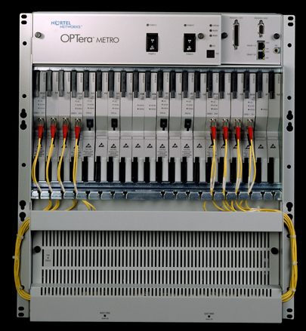
Nortel and Cisco SONET Optical Switches

Slide 8
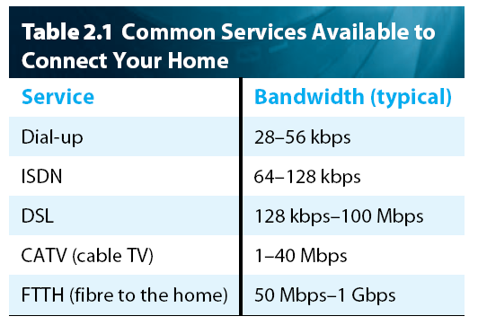
Table 2.1 Common Services Available to Connect Your Home
*
(Obsolete in US)
(Mostly obsolete)
(CenturyLink etc.)
3 – 100Mbps
(Cable modem - Comcast etc.)
25 – 100Mbps
†“Broadband”
(Google, UTOPIA)
*Updated to reflect local offerings
†FCC’s definition of “broadband” is >25Mbps downlink and >3Mbps uplink

Slide 9
Encoding vs. Modulation
We assume that the data to be transmitted is originally in digital form (bits), stored in computer memory (RAM etc.)
The process of converting that digital data into a format suitable for communication over a digital communication system (like an Ethernet or a fiber optic link) is called encoding
The process of converting digital data into a form suitable for communication over an analog communication system (like a wireless LAN, DSL or a cell tower) is called modulation or shift keying

Slide 10
Transmission Hardware Terms
The hardware for analog transmission and reception on guided analog media as well as any unguided medium is a modem (modulator-demodulator)
A modem takes bits out of memory and converts them into an analog signal using a modulation or shift keying process
Examples of equipment using modems:
DSL modem
Cable modem
Cellular modem (in your smartphone)
The hardware for digital transmission and reception on a guided digital medium is called a codec (coder-decoder)
A codec takes bits out of memory and converts them into a digital signal using a process called encoding
Examples of equipment using codecs:
DSU/CSU for DS1 (T1) and DS3 (T3) circuits
Ethernet adapter (an Ethernet codec is called a transceiver)

Slide 11
Encoding Data for Transmission Over a Digital Link

Slide 12
Figure 2.4 NRZ* Encoding of a Bit Stream
+
0 volts
–
edges
one bit time
(clock interval)
*Non-return to zero

Slide 13
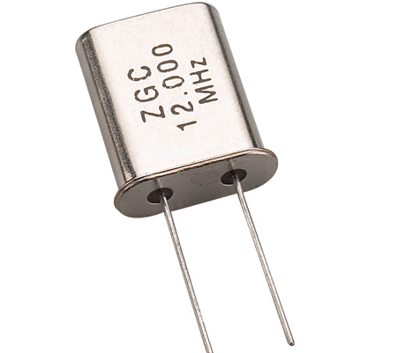
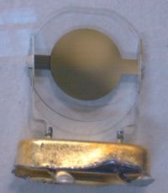
A Quartz Crystal Oscillator “Clock”
A 12 MHz Oscillator
Oscillator with cover removed

Slide 14
Example of Clock Drift with NRZ*

Slide 15
Different Encoding Strategies (Based on Figure 2.5)
Check out Shaun Carlson’s simulator demonstrating these encoding systems at
http://mogman1.github.io/encodings/

Slide 16
Baud Rate vs. Data Rate
We know data rate as the number of data bits that can be transmitted per second (as in “10Mbps”)
The baud rate is the number of state changes per second in the signal (as in a “1200 baud modem”), also called the symbol rate
In the past, data rate (bps) and symbol rate (baud) tended to be equivalent (1200 baud meant 1200bps)
Many modern analog and digital systems can transmit more than two distinct symbols (thus more than one bit) per baud
For example, a system with four distinct symbols can represent one of four different values with each new symbol, therefore two bits worth of data
For example, symbol A = 00, B = 01, C = 10 and D = 11 (2 bits per baud)
Conversely, some systems require multiple symbols (state changes) per bit
Manchester requires two state changes per bit (½ bit per baud)
Baud rate is governed by true (analog) bandwidth, i.e., the range of available frequencies that can be transmitted, also called spectrum
Enabling multiple bits per baud allows higher data rates within the confines of existing frequency spectrum, thus more efficient use of scarce radio spectrum

Slide 17
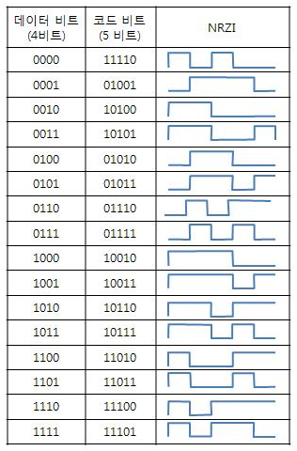
4B/5B Encoding (See Table 2.2)
4B
5B
Alias
4B
Based on http://ryusstory.tistory.com/entry/4B5B%EB%9E%80

Slide 18
Quiz Next Time
Covers from beginning of chapter 2 up to section 2.2 (pages 71 – 78, Lectures 7 - 10). That includes all types of transmission media, analog and digital signals, and the various telecommunications services. (Encoding is not included on this quiz.)

Slide 19
Homework Question 1.
1. Show the NRZ, Manchester, and NRZI encodings for the bit pattern shown in Figure 2.36 on p. 153 (10011111 00010001). Assume that the NRZI signal starts out low. (You may draw these signals with a pencil if you like. Either scan your hand drawing or take a sharp photo of it, then paste that into an rtf, odt, doc, docx, or pdf file for submission to Canvas.) (6 points)

Slide 20
Homework Question 2.
2. Show the 4B/5B encoding, and the resulting NRZI signal, for the following bit sequence. (Use Table 2.2 on page 82 for translation and assume that the NRZI signal starts out low. This can also be hand drawn and scanned for submission to Canvas.) (4 points)
11100101 00000011

